Slide 1


Credit Card Usage Segmentation.
This presentation is focused on segmenting credit card users based on their spending patterns. By leveraging machine learning techniques, we aim to identify distinct customer segments and understand their behavior for targeted marketing and business optimization.
by Rishita Shah

Slide 2
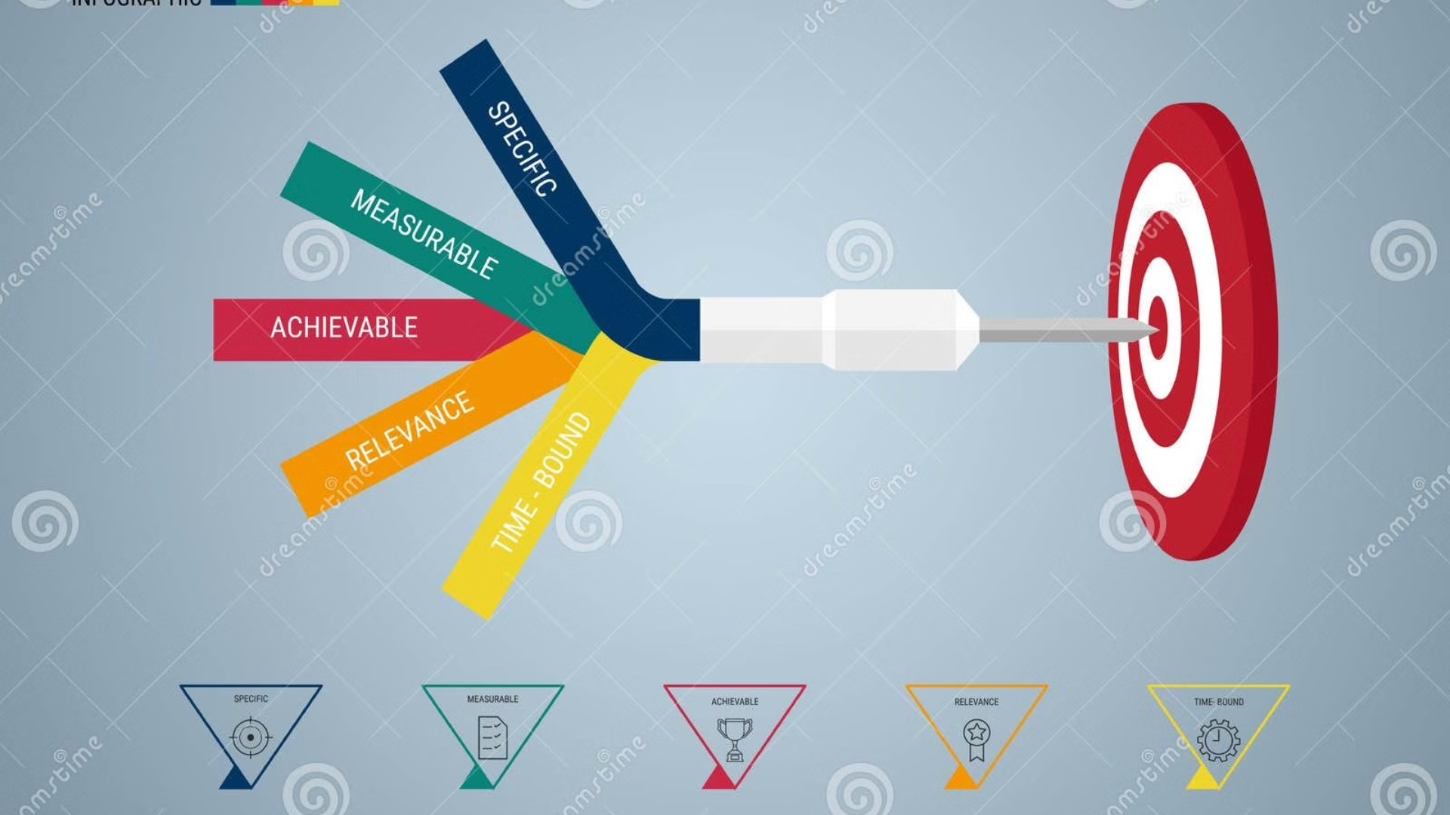
Introduction :
Objectives :
Dataset :
Importance:
The objective of this project is to develop an accurate unsupervised learning model based on credit card usage data. This segmentation enables better understanding of customer needs, supports decision-making for product development and customer retention.
The dataset contains 8,950 records detailing customer financial behavior, including balances, purchases, credit limits, and payment history. Key metrics such as purchase frequency, cash advances, and account tenure are included for comprehensive analysis.
The importance of a credit card usage segmentation project lies in its ability to drive strategic decision-making, improve customer experience, and enhance business profitability. It allows businesses to better understand customer needs, create personalized marketing strategies, and grow revenue.

Slide 3
Steps :
1
Data Collection
Gathering and organizing data to train machine learning models.
2
Exploratory Data Analysis
Analyzing and visualizing data patterns to understand its characteristics.
3
Preprocessing
Preparing and cleaning data to enhance its quality and suitability.
4
Split Train and Test Data
Dividing the dataset into training and testing sets to evaluate.
5
Model Selection and Model Training
Choosing a suitable machine learning algorithm and optimizing its parameters.
6
Model Evaluation
Assessing the performance of machine learning model using metrics.

Slide 4


Data Collection and Refinement:
Credit Card Usage Segmentation:
8950 Rows
18 Columns
Variable
Description
CUST_ID
Unique identifier for each customer.
BALANCE
The balance amount on credit card.
BALANCE_FREQUENCY
Frequency of balance updates
0 = Least frequent
1 = Most frequent
PURCHASES
Total amount of purchases made.
ONEOFF_PURCHASES
Amount spent on one-off purchases.
INSTALLMENTS_PURCHASES
Amount spent on installment purchases.
CASH_ADVANCE
Cash advance amount taken by customer.
PURCHASES_FREQUENCY
Frequency of purchases made
0 = Least frequent
1 = Most frequent
ONEOFF_PURCHASES_FREQUENCY
Frequency of one-off purchases
0 = Least frequent
1 = Most frequent
PURCHASES_INSTALLMENT_
Frequency of installments purchase
FREQUENCY
0 = Least frequent
1 = Most frequent
CASH_ADVANCE_FREQUENCY
Frequency of cash advances
0 = Least frequent
1 = Most frequent
CASH_ADVANCE_TRX
Number of cash advance transactions.
PURCHASES_TRX
Number of purchase transactions.
CREDIT_LIMIT
Credit limit assigned to customer.
PAYMENTS
Total payments made by customer.
MINIMUM_PAYMENTS
Minimum payments made by customer.
PRC_FULL_PAYMENT
Percentage of full payments made.
TENURE
Number of months the customer has been with the bank.

Slide 5
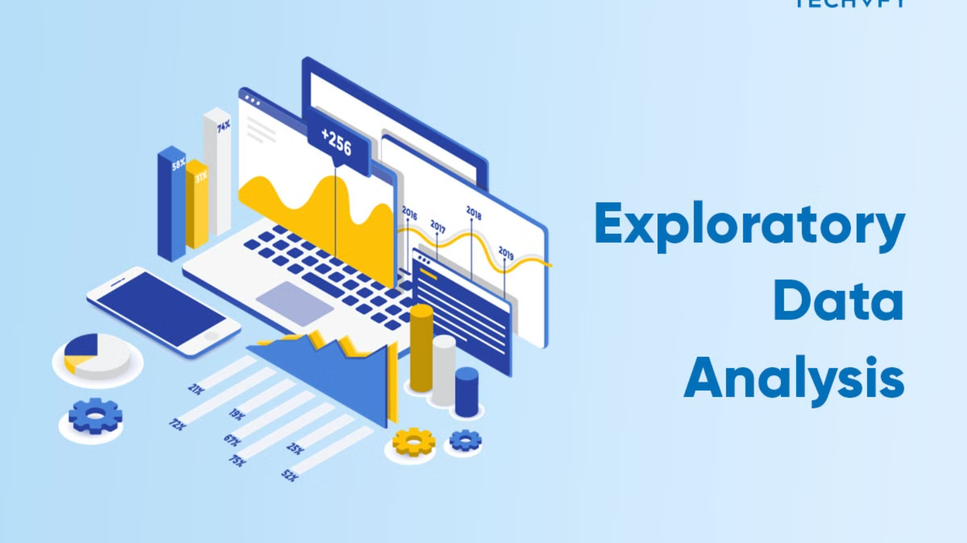
Exploratory Data Analysis
Descriptive Statistics
Visualizations
This step involves calculating basic statistics like mean, median, and standard deviation of key features, to understand data characteristics.
Creating visualizations like histograms, scatter plots, and box plots helps understand data patterns and outliers in the data.
1
2
3
Correlation Analysis
Examining correlations between features reveals potential relationships and helps identify which features are most relevant for segmentation.

Slide 6

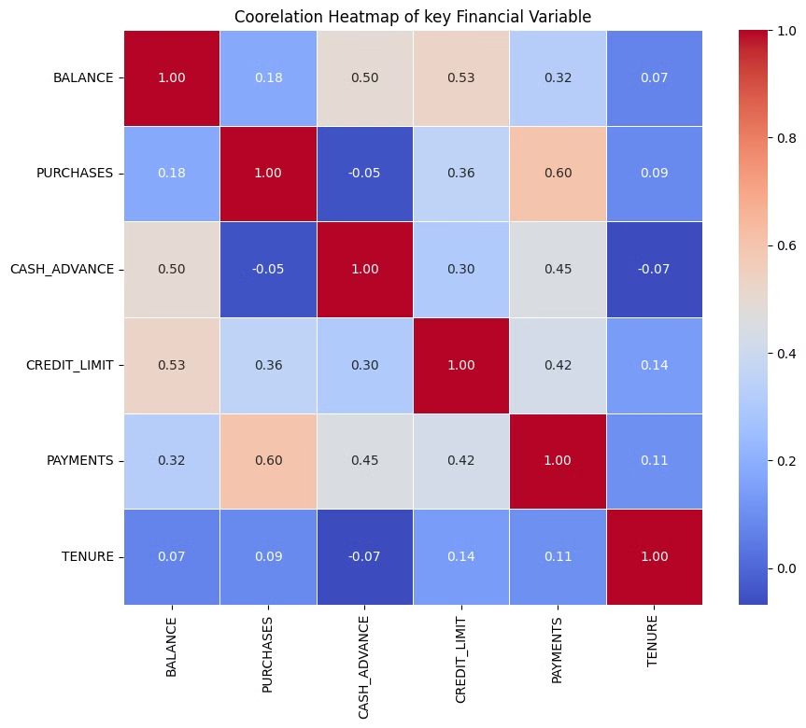
Correlation Heatmap of Key Financial Variables.
The correlation heatmap displays the relationships between key financial variables such as Balance, Purchases, Cash Advance, Credit Limit, Payments, and Tenure. Notable correlations include a strong positive relationship between Balance and Credit Limit (0.53) and between Payments and Purchases (0.60), indicating how credit usage impacts spending and payment behaviors.

Slide 7

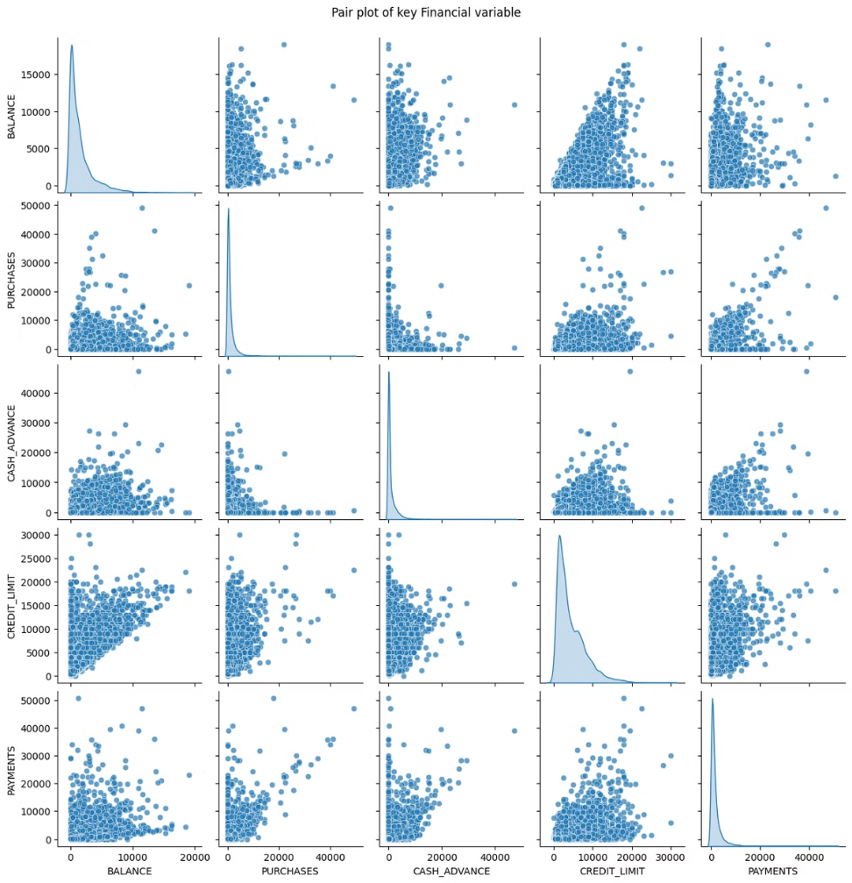
Distribution of Continuous Features in Credit Card Usage Data.
The histograms illustrate the distributions of various continuous features in the dataset, highlighting their skewed nature, with most data points concentrated in the lower ranges.
This indicates the presence of a few high-value outliers, suggesting variability in customer behavior

Slide 8

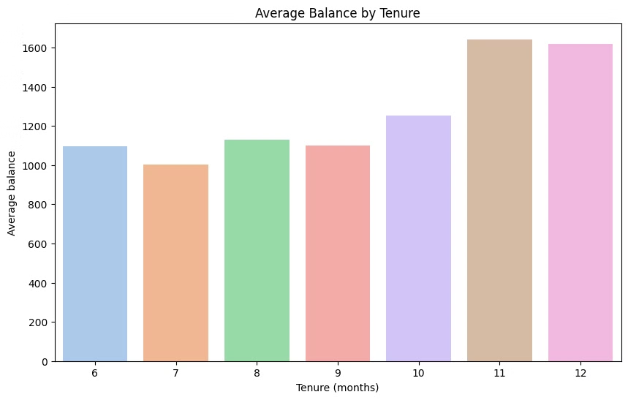
Impact of Tenure on Average Balance .
The bar chart shows the average balance by customer tenure, indicating a clear upward trend.
Customers with longer tenure (11-12 months) maintain higher average balances, peaking at over 1600, suggesting increased financial engagement over time.

Slide 9

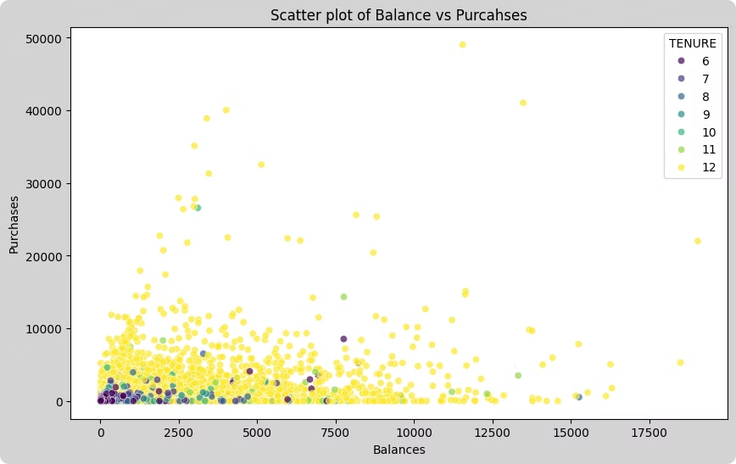
Relationship Between Purchases and Balance by Tenure .
The scatter plot shows the relationship between Purchases and Balance across different tenures.
Higher balances are generally associated with lower purchase amounts, and customers with longer tenures (especially 12 months) have a wider distribution of balances, indicating diverse spending behaviors.

Slide 10


Data Collection and Preprocessing.
1
Data Sources
Collect credit card transaction data from various sources, such as transaction logs, customer profiles, and marketing databases.
2
Data Cleaning
Remove inconsistencies, missing values, and outliers to ensure data quality and accuracy.
3
Data Transformation
Transform raw data into a format suitable for analysis, such as normalization, scaling, and encoding categorical variables.
4
Feature Engineering
Create new features from existing ones to improve model performance.

Slide 11

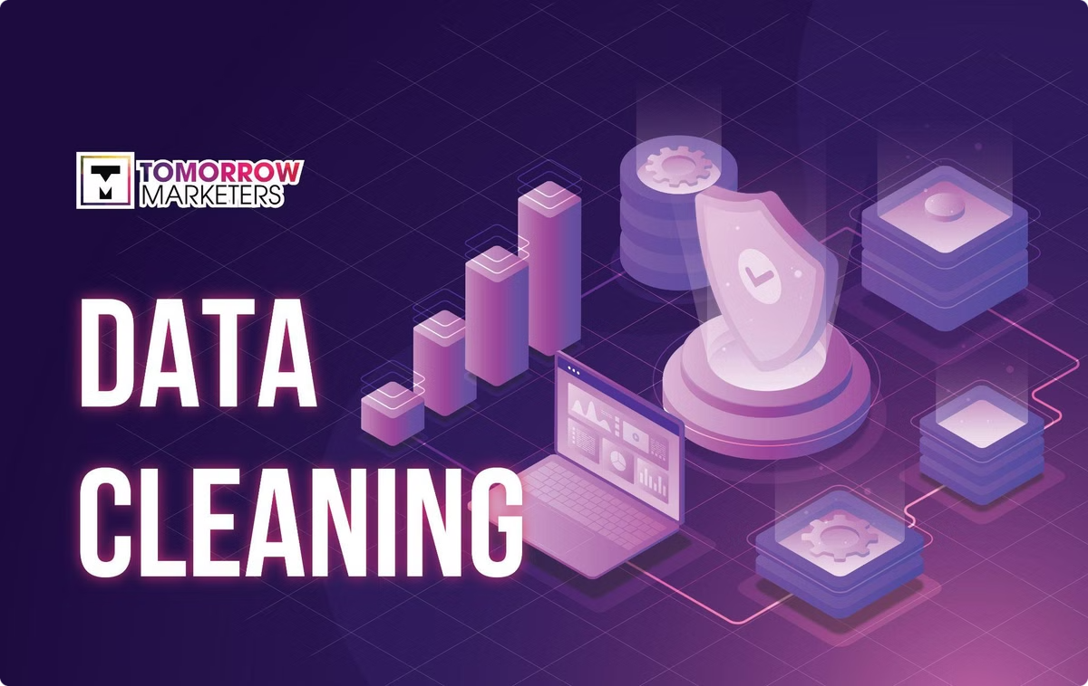
Data cleaning and Outlier Handling :
Customer Data
Data cleaning and outlier handling are crucial steps in any data analysis project, as they ensure the accuracy, reliability, and validity of the results. By removing inconsistencies, missing values, and outliers, we can obtain a clean and consistent dataset that provides a more accurate representation of the underlying patterns and trends.
The credit card usage dataset contains 8,950 records, representing individual customers' financial behavior. Each record includes attributes like balance, purchases, credit limit, payment history, purchase frequency, cash advances, and account tenure.
These attributes provide a comprehensive overview of customer financial activity, enabling us to develop a robust segmentation model.

Slide 12

Data Cleaning and Outlier Handling : Customer data
Missing Values :
CREDIT_LIMIT : 1 missing value .
MINIMUM_PAYMENTS : 313 missing values .
Fix :
Mean Imputation : Replace missing CREDIT_LIMIT with the mean of the column .
Median Imputation : Replace missing MINIMUM_PAYMENTS with the median of the column .
Duplicates :
No duplicates found in the datasets .

Slide 13

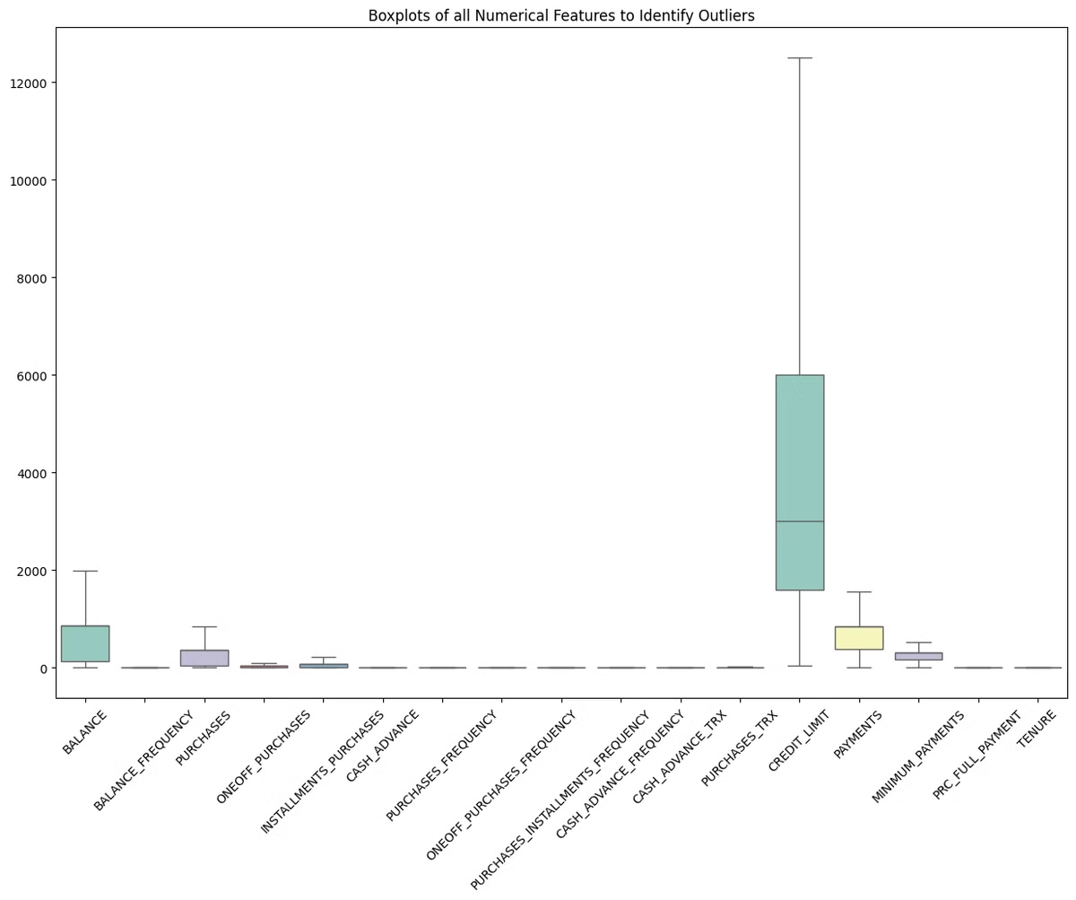
Outlier Detection & Handling :
Outlier Detection :
Explain the IQR method used to identify outliers.
Highlights outliers in key columns :
* BALANCE : 695 outliers.
* PURCHASES : 808 outliers.
Handling Strategies :
Imputing Outliers : Replace outlier values with more typical values within a certain range, such as the mean or median, to reduce their impact .
Visual : Boxplot or brief graphic showing outlier distribution and imputation strategy.

Slide 14
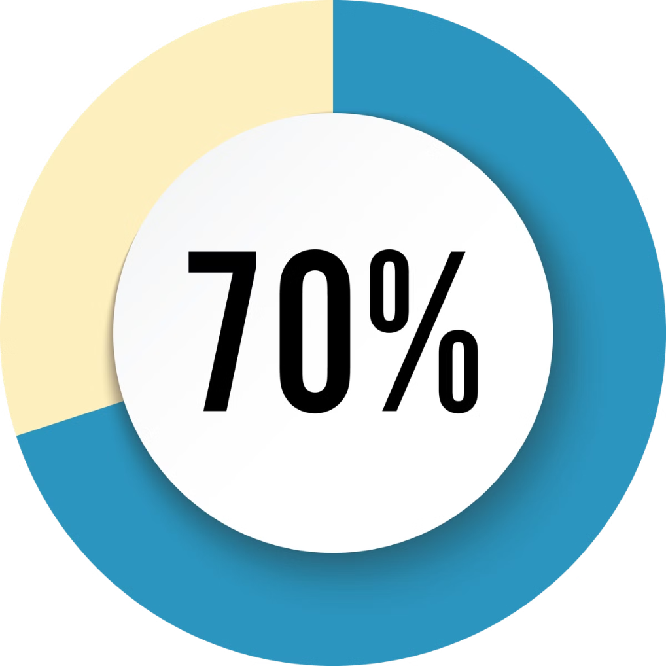
Data Splitting for Decision Tree Model :
X : 70% Y : 30%
Objective : Split the dataset into training and testing sets to build a Decision Tree model for segment interpretation.
Code Review :
Features X - All relevant features except CUST_ID, Cluster, and PCA components [pca_one,pca_two] .
Target Y - The Cluster label indicating customer segments .
3. Data Splitting :
Method - Used train_test_split to divide the dataset.
Split Ratio - 70% training data, 30% testing data.
Random State - Set to 42 to ensure reproducibility of results.
4. Visual : Diagram showing the data split into training [70%]) and testing [30%]) sets, leading to model training and evaluation.

Slide 15
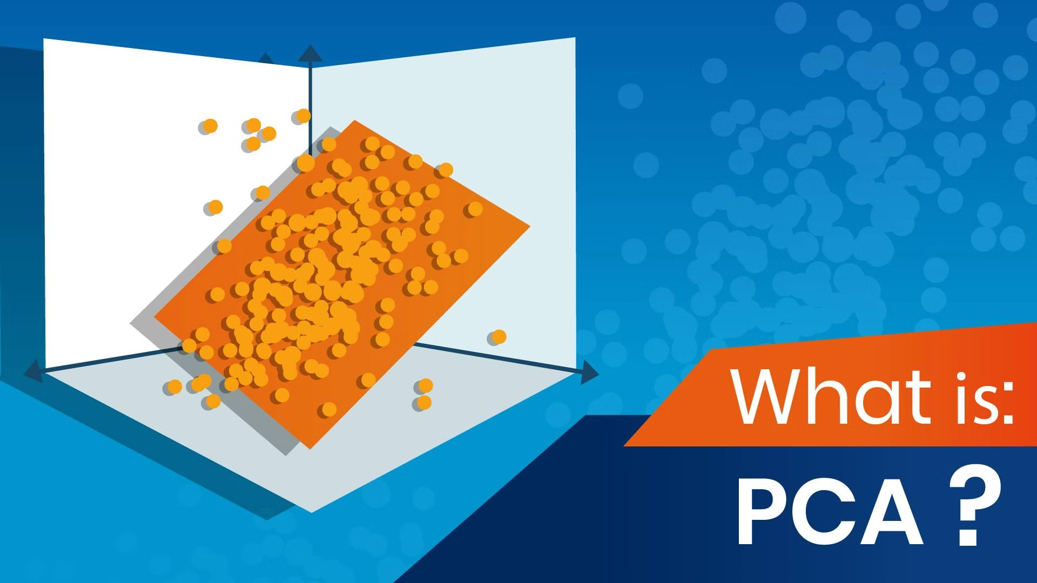
Dimensionality Reduction :
Import Principal Component Analysis [PCA]
Sometimes dataset have too many features , which makes analysis complicated.
PCA helps by Reducing the number of features while keeping as much important information as possible.
How PCA works ?
PCA looks for pattern in the data to identify the direction where data varies the most.
PCA creates directions that are combinations of the original features.
First Principal component [PC1] : Capture the most variation.
Second Principal component [PC2] : Captures the second most variation.
Key Benefits :
Simplifies data : Reduce the number of Features .
Speed up analysis : Makes computation Faster .
Improves Visualization : Makes it easier to plot high-dimensional data in 2d or 3d .

Slide 16
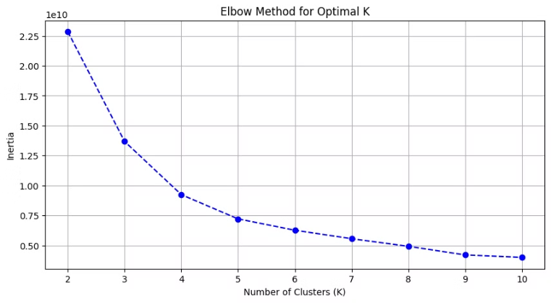
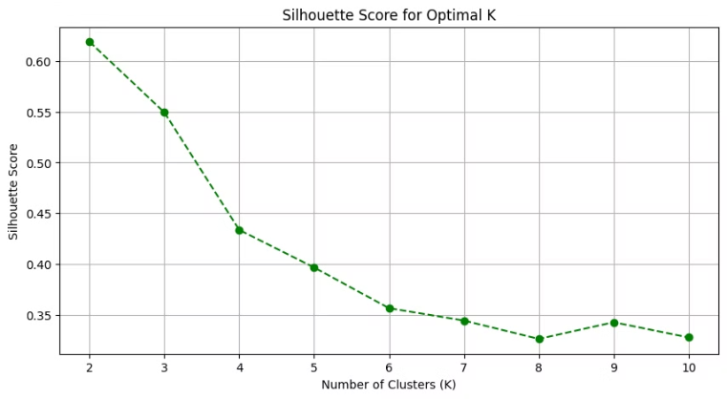
Clusters :
Elbow Method
Silhouette Score
Elbow Method is simple technique used in clustering [like in k-means] to find the best number of clusters for your data .
Silhouette score is simple way to measure how good your clusters are after performing clustering.
The optimal number of cluster is k=4 .
It helps you decide whether your data points are well grouped into clusters.
The optimal number of Cluster is k=2 with a value above 0.6

Slide 17

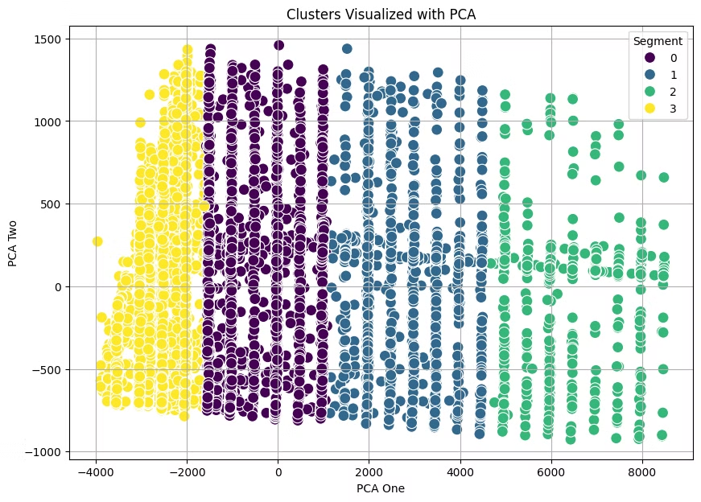
Clusters are created on the basis of Segments .
In this final step , we apply our model to classify users based on their credit card usage into 1 of 4 segments .
There are 4 clusters [0,1,2,3] .
1. Segment [0] (Purple) : Customers with a high spending , frequent transactions.
2. Segment [1] (Blue) : Average customers with moderate spendings ; balancing between purchases and payments .
3. Segment [2] (Green) : Below - Average customers with lower spendings , limited engagement .
4. Segment [3] (Yellow) : Least active customers with minimal spendings , prefers stability in their spendings .
Every row in the dataset is now grouped into one of 4 clusters , as indicated by the segment column.

Slide 18


Introduction to Model Building.
Objective :
To develop predictive models that can accurately classify customer segments.
Process Overview :
Data Preparation : Cleaned and split the data into training and testing sets.
Model Selection : Chose diverse algorithms to ensure comprehensive analysis.
Training : Each model was trained on the training set to learn patterns.
lEvaluation : Models were evaluated using testing data to measure performance.
Comparison : Models are compared based on metrics like accuracy, precision, recall, and F1-score.

Slide 19
Models Implemented for Prediction.
* Decision Tree
* K - Nearest Neighbors [KNN]
* Random Forrest
Interpretable model that splits data based on feature values. Ideal for understanding decision processes and identifying key features.
Ensemble of decision trees that improves accuracy and reduces overfitting. Useful for large datasets and complex relationships.
Instance-based learning that classifies data points based on their proximity to nearest neighbors. Useful for non-linear data and small datasets.
* Support Vector Machine [SVM]
Finds the optimal hyperplane that separates classes. Robust and effective for high-dimensional data and complex classifications.

Slide 20
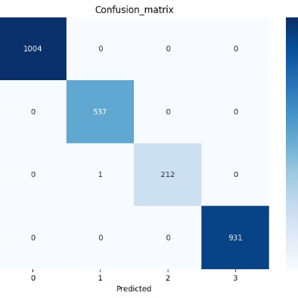



Comparative Analysis of Confusion Matrices for Model Evaluation.
Decision Tree
KNN
Random Forest
SVM

Slide 21
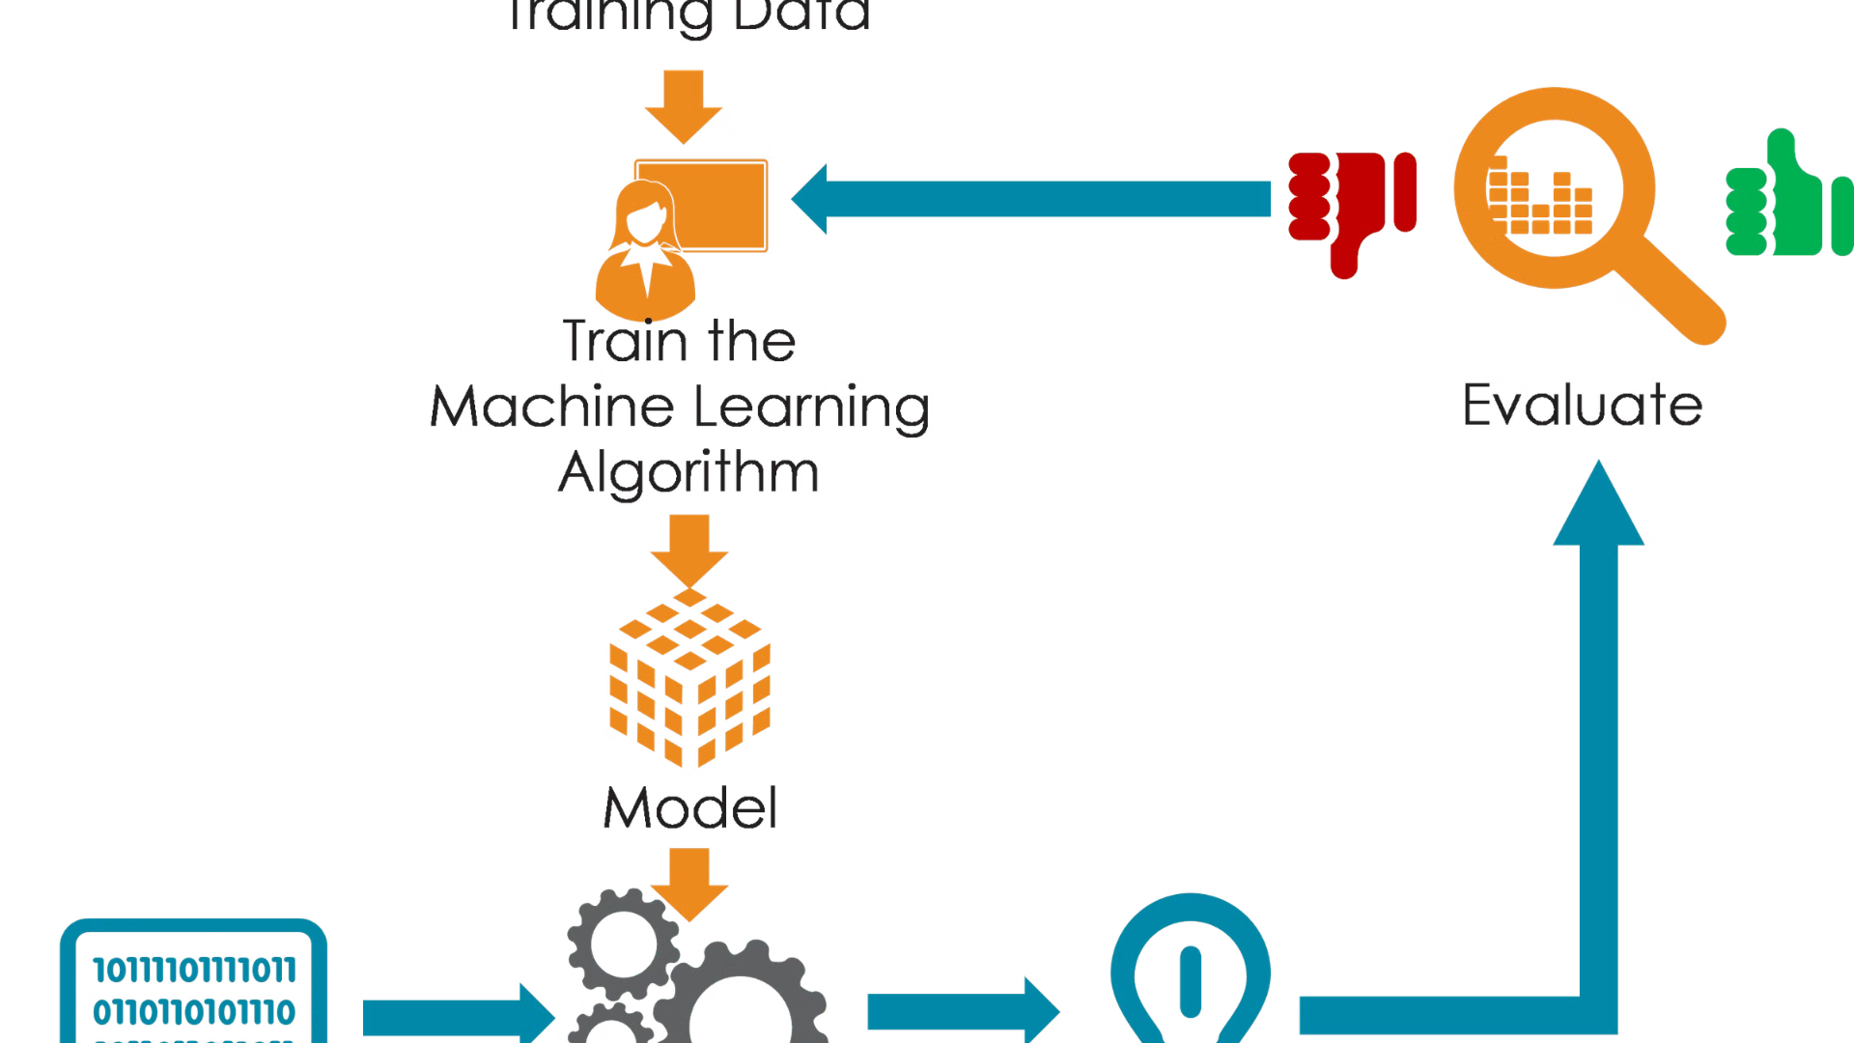
Model Performance Summary :
This slide provides a summary of key metrics and confusion matrices for evaluating the performance of 4 machine learning models .
Model
Accuracy
Precision
Recall
F1 score
Decision Tree
0.8400
0.8689
0.81290
0.8400
KNN
0.8033
0.8478
0.754
0.7986
Random Forest
0.8666
0.8859
0.8516
0.8684
SVM
0.8333
0.8571
0.8129
0.8344

Slide 22

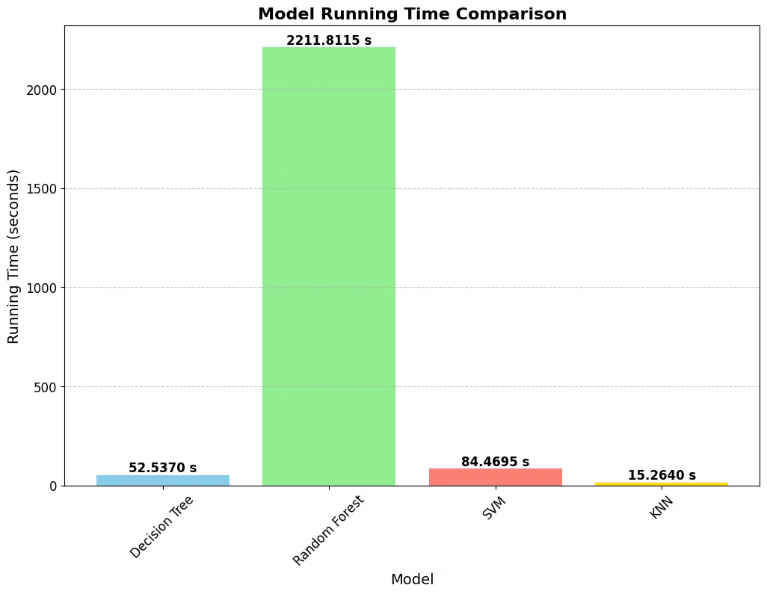
Timing Analysis and Model Selection.
The graph illustrates the build times for each model, revealing significant differences in computational efficiency .
The Decision Tree model stands out not only for its high performance but also for its efficiency, requiring the least amount of time to build.
Choosing a model that balances both accuracy and efficiency ensures optimal use of computational resources, making the Decision Tree a practical choice.
Moving forward, using the Decision Tree model will enable us to maintain high performance while also benefiting from faster processing times during deployment and future updates.

Slide 23
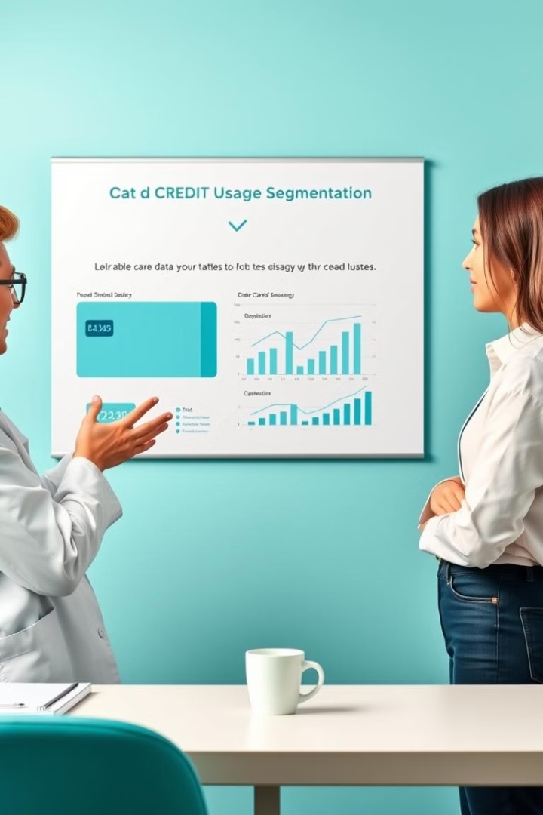
Conclusion & Future Considerations:
This segmentation model is a foundational tool that can be expanded upon with more data and advanced techniques to drive business growth and customer satisfaction.
ENHANCEMENT :
Real - Time data integration : Incorporate real-time data to refine and update segments continuously.
Multi - Source Data Fusion : Integrate data from other sources like social media and transactional logs to enhance the accuracy of the segmentation.

Slide 24


Thank You!
Thank you for your time and attention. Your feedback and insights have been truly invaluable, and we look forward to any further thoughts you may have.

